Slide 1
FISH270
Lecture 2

Slide 2
Last time
Questions about logistics or anything?

Slide 3
Last time
What did you do since then?

Slide 4
Last time
Main points

Slide 5
Today
Form and Function
Homeostasis

Slide 6
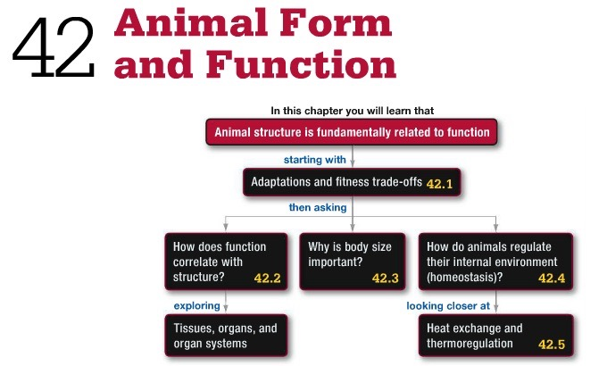

Slide 7
Anatomy and Physiology

Slide 8
Adaptations

Slide 9
Adaptations
Heritable traits that allow individuals to…

Slide 10
Adaptations occur through…

Slide 11
Role of fitness trade-offs

Slide 12
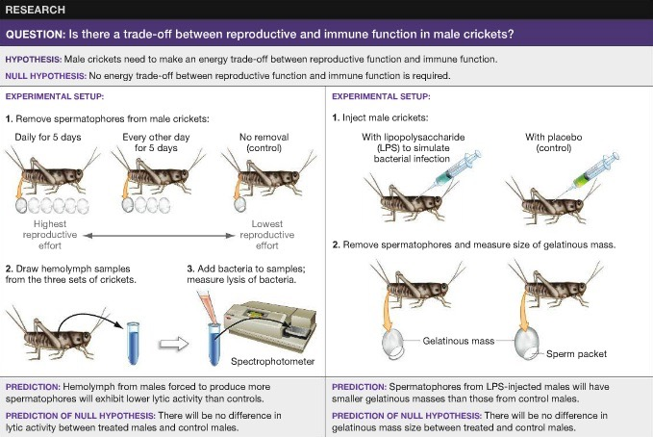

Slide 13
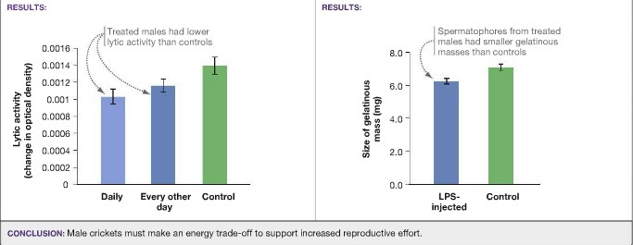

Slide 14
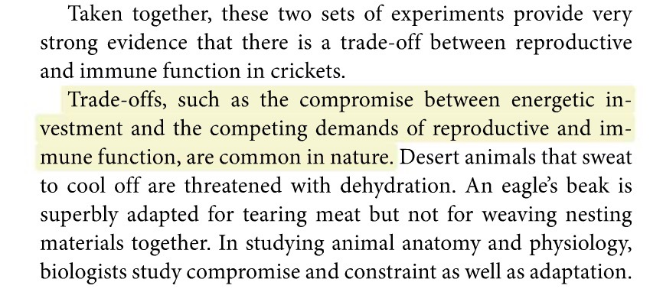

Slide 15
Adaptation and Acclimatization

Slide 16
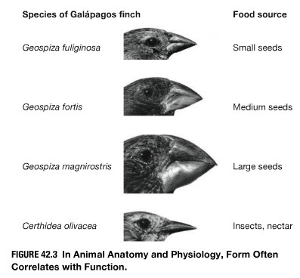
Structure and Function

Slide 17
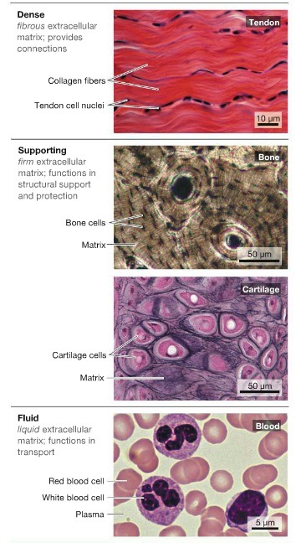
Structure and Function

Slide 18
Structure and Function
Connective tissue
Nervous tissue
Muscle tissue
Epithelial tissue

Slide 19
Structure and Function
Connective tissue
Nervous tissue
Muscle tissue
Epithelial tissue

Slide 20
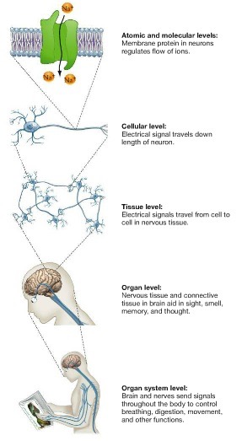
Structure and Function

Slide 21
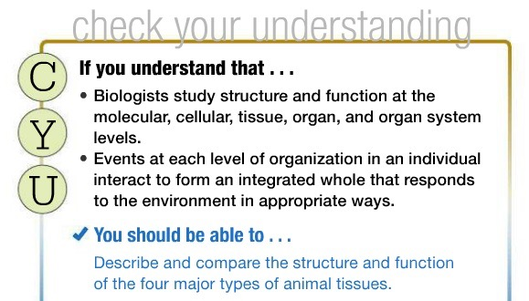
Structure and Function

Slide 22
Body size and Physiology

Slide 23
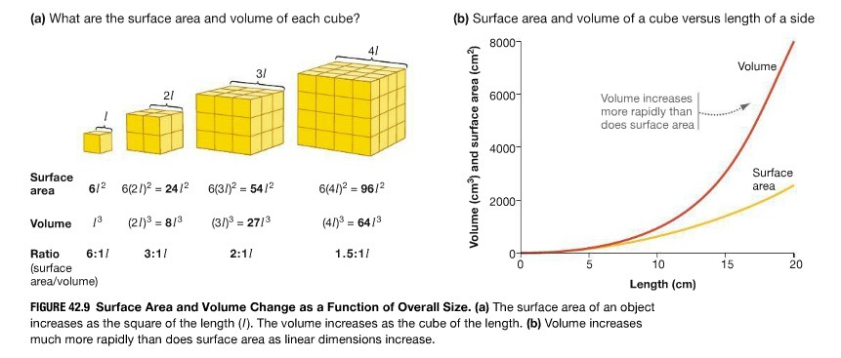
Body size and Physiology

Slide 24
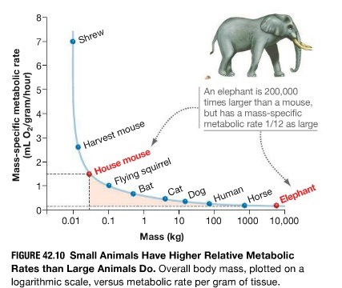
Body size and Physiology

Slide 25
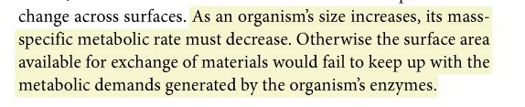
Body size and Physiology

Slide 26
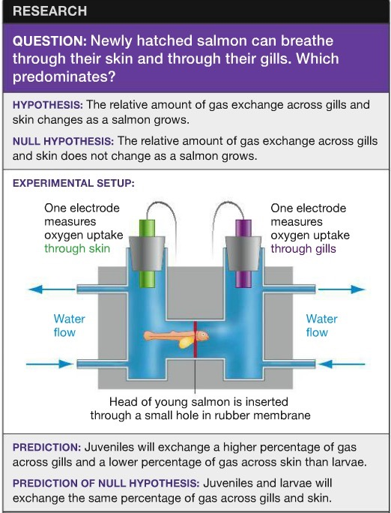
Salmon!!!

Slide 27
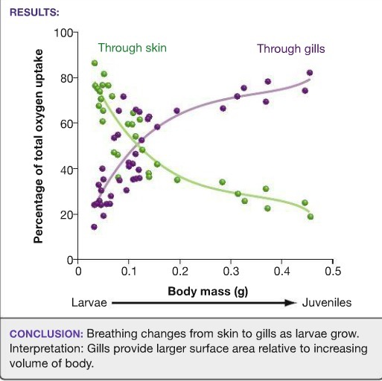
Salmon!!!

Slide 28
Can surface area be increased?

Slide 29
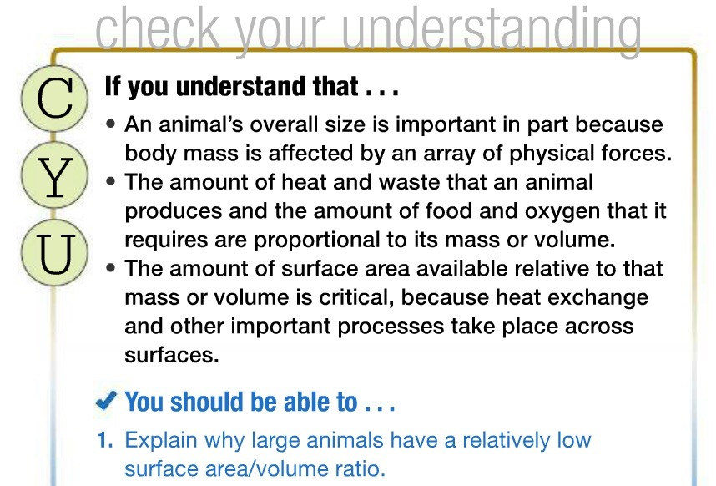

Slide 30
Homeostasis

Slide 31
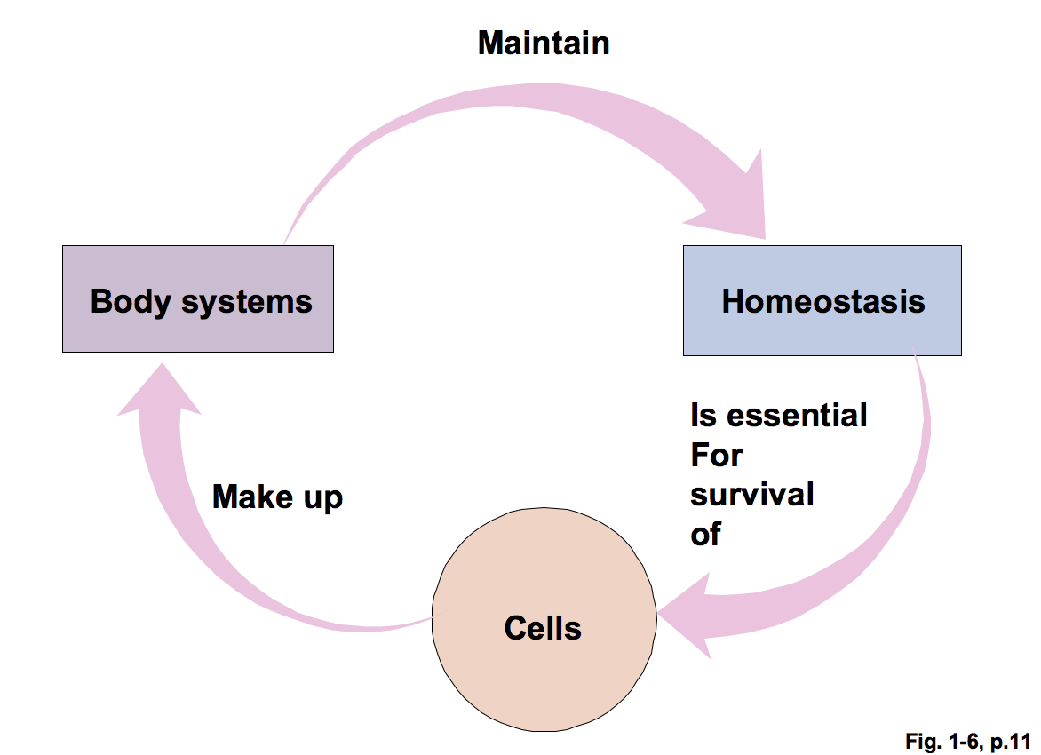
Homeostasis
Notes:
dynamic
breathing

Slide 32
Homeostasis

Slide 33
internal
external
stressors
Notes:
enantiostatis or allostasis

Slide 34
Homeostasis
Factors of internal environment often regulated
Notes:
page 10/11

Slide 35
Homeostasis
Factors of internal environment often regulated
Concentration of energy rich molecules
Concentration of O2 and CO2
Concentration of waste products
pH
Concentration of water, salt, and other electrolytes
Volume and pressure
Temperature
Social Parameters
Notes:
page 10/11

Slide 36
Homeostasis
Most intrinsic and extrinsic control systems generally operate on the principle of negative feedback
Inadequacies in basic negative feedback systems can be improved with feedforward systems and acclimatization systems.
Pathophysiological states ensue when one or more of organisms systems fail to function properly.

Slide 37
Homeostasis
Text
Notes:
negative feedback

Slide 38
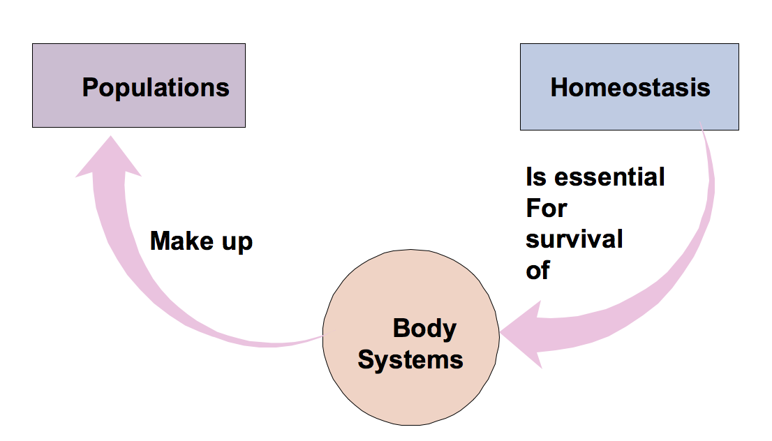
Homeostasis
Ecological Perspective
Notes:
social parameteres

Slide 39
Homeostasis
Most intrinsic and extrinsic control systems generally operate on the principle of negative feedback
Inadequacies in basic negative feedback systems can be improved with feedforward systems and acclimatization systems.
Pathophysiological states ensue when one or more of organisms systems fail to function properly.

Slide 40
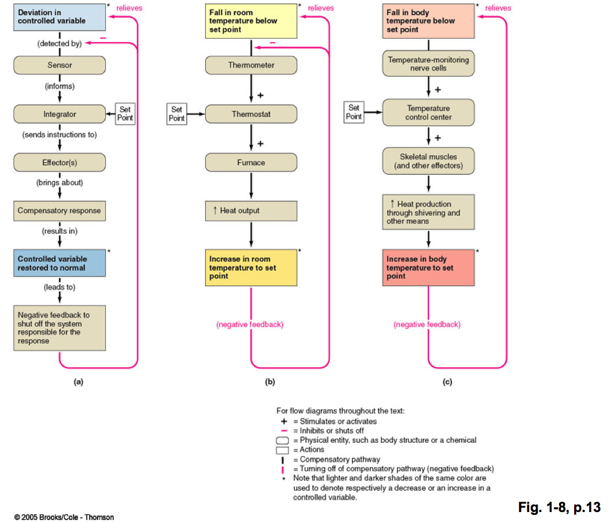
Maintenance
Notes:
referenced have set point

Slide 41
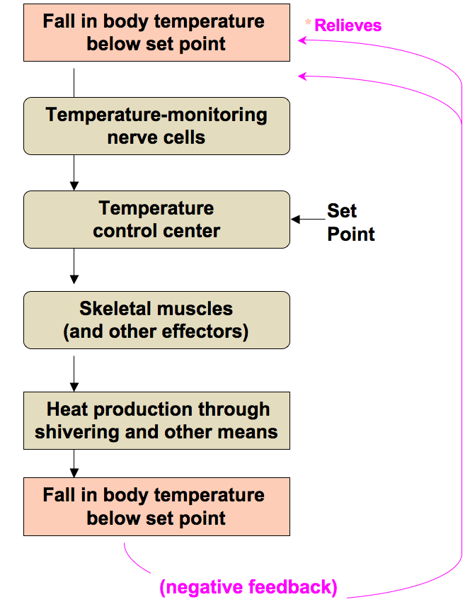
Maintenance

Slide 42
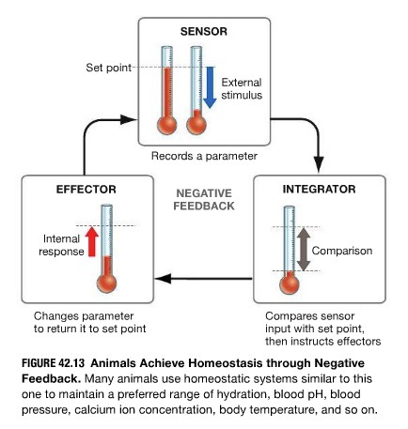

Slide 43
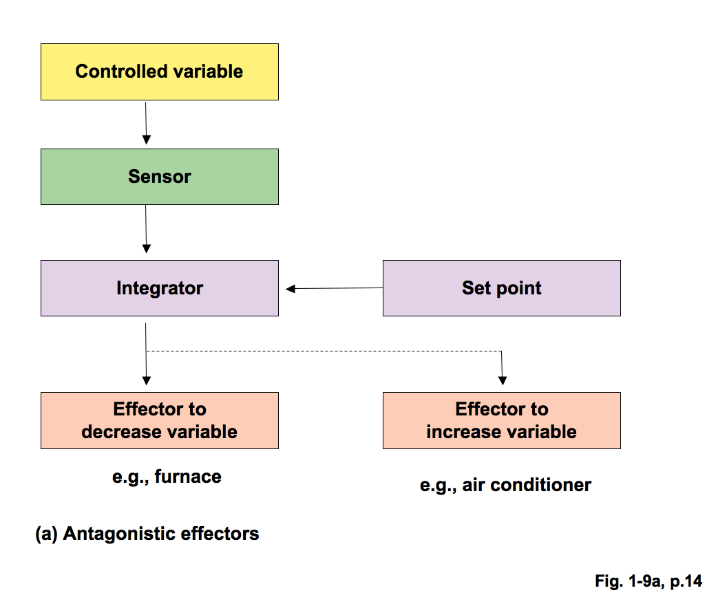
Antagonistic control

Slide 44
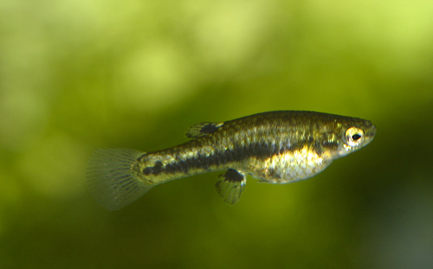
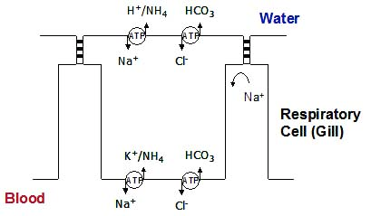
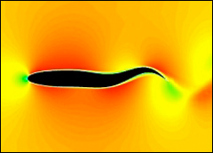
Effector
Internal cells AND
Behavior
Killifish and salinity
by brian.gratwicke
http://www.oxyedge-chum.com/oxygen_or_salt.htm
Notes:
Effectors there are two
Cells in the gill
Swim

Slide 45
Improving negative feedback
why?
Notes:
delayed response
delay in turning off
New environment or situation

Slide 46
Improving negative feedback
Anticipation
Acclimatization
Notes:
feed forward - insulin secretion while food is in digestive tract
acllimation - lab
adaptation ? evolutionary or organismal

Slide 47
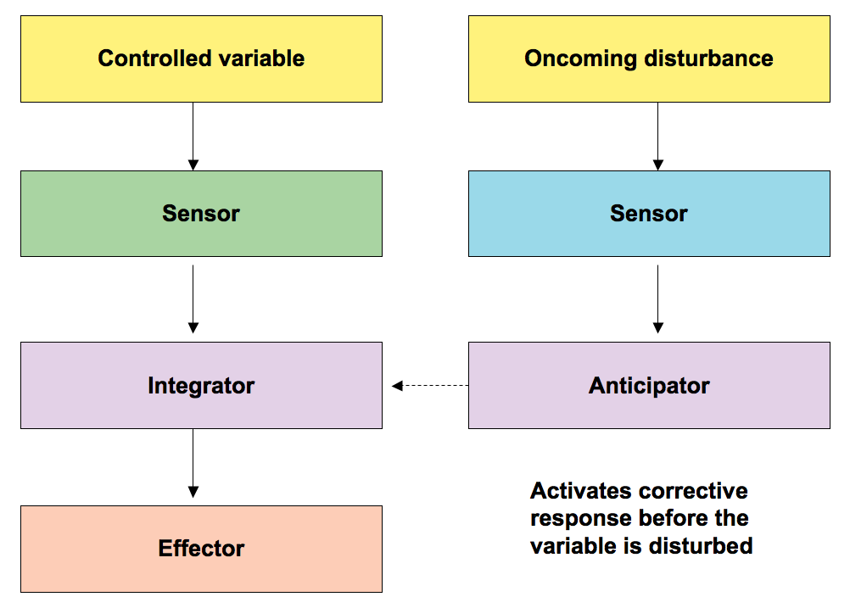
Improving negative feedback
Anticipation
Acclimatization
temp
food
Notes:
feed forward - insulin secretion while food is in digestive tract
acclimation - lab
adaptation ? evolutionary or organismal

Slide 48
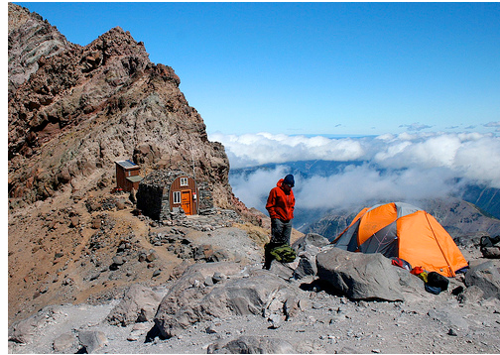

Improving negative feedback
Anticipation
Acclimatization
Notes:
feed forward - insulin secretion while food is in digestive tract
acclimation - lab
adaptation ? evolutionary or organismal

Slide 49
Acclimatization
acclimation
adaptation
Notes:
feed forward - insulin secretion while food is in digestive tract
acllimation - lab
adaptation ? evolutionary or organismal

Slide 50
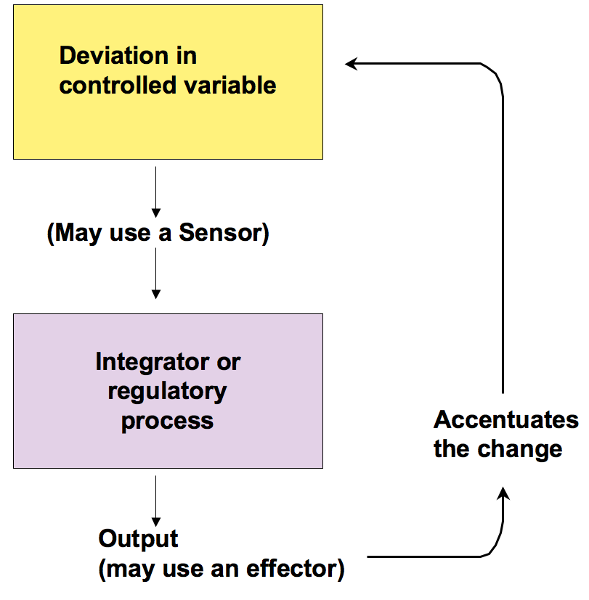
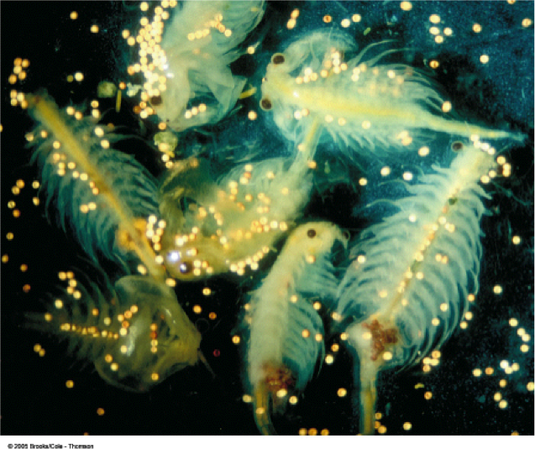
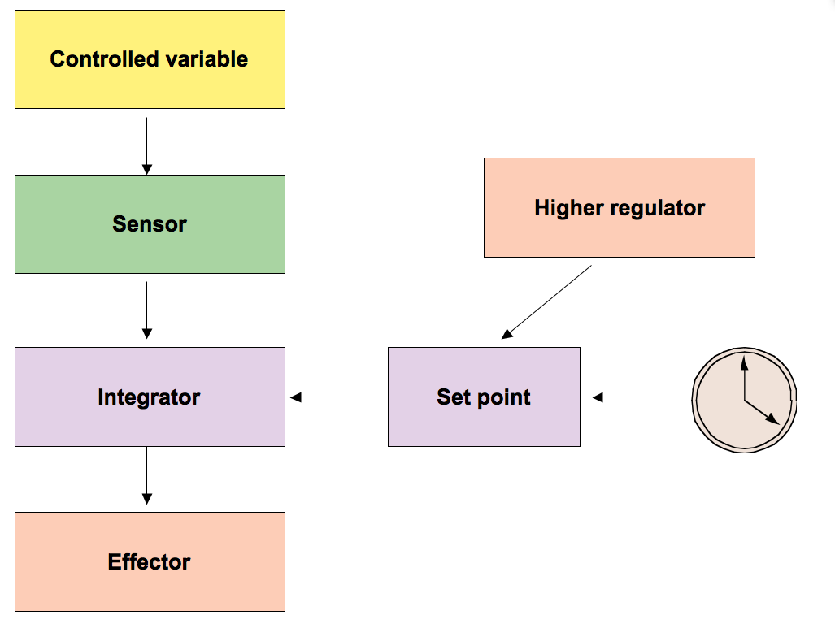
Regulated change
when things are not homeostatic
Dormancy
Reset System
Positive Feedback
acclimatization taken to non-homeostatic state
negative feedback will not do.
Notes:
acclimatization taken to non-homestatic

Slide 51
Regulated change
when things are not homeostatic
Dormancy
Reset System
Positive Feedback
Notes:
acclimatization taken to non-homestatic

Slide 52
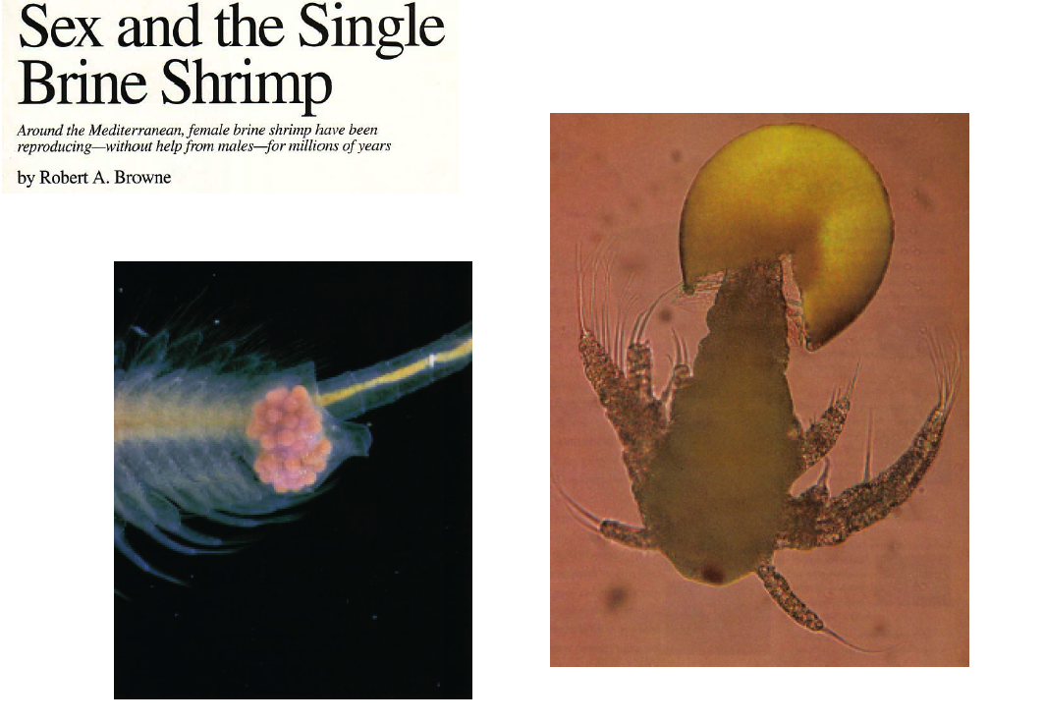
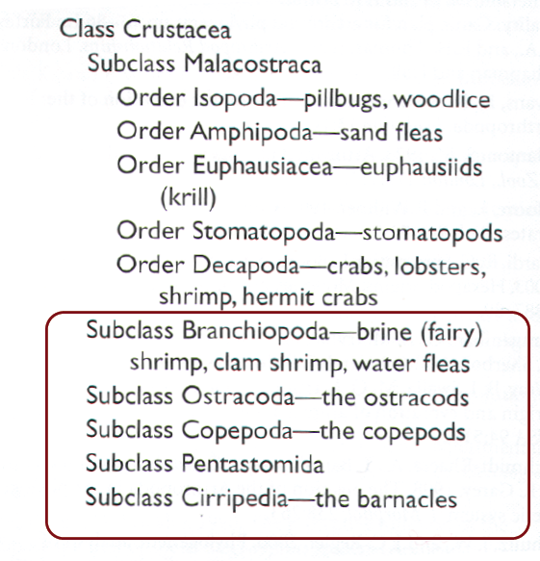
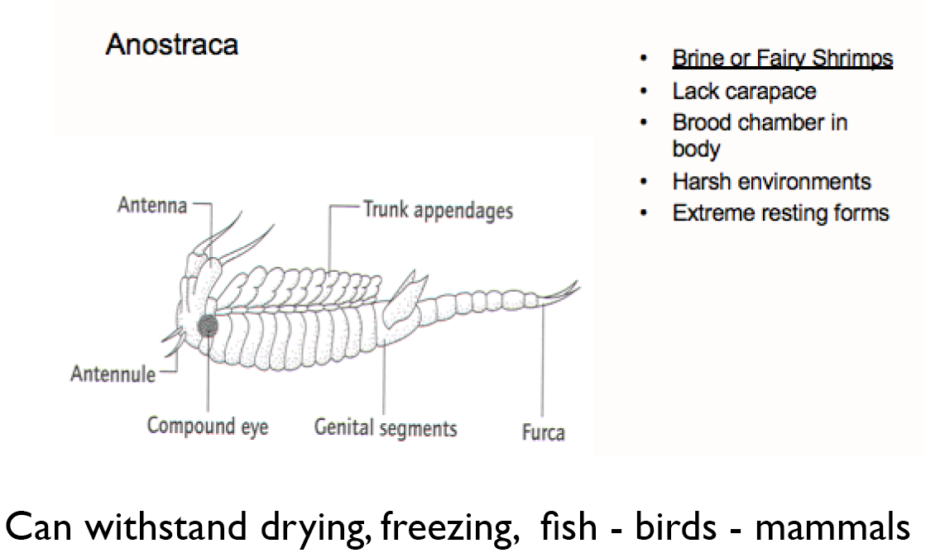
Brine Shrimp

Slide 53
Regulated change
Dormancy
Reset System
Positive Feedback
when things are not homeostatic

Slide 54
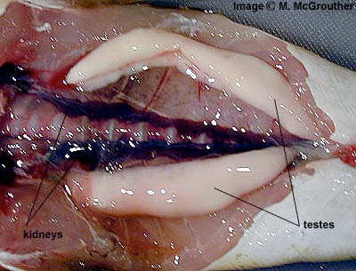
Regulated change
Dormancy
Reset System
Positive Feedback
when things are not homeostatic

Slide 55
Regulated change
Dormancy
Reset System
Positive Feedback
when things are not homeostatic

Slide 56
Examples of positive feedback
when things are not homeostatic
Notes:
blood clotting
immune response
lactation
mating behaviour

Slide 57
Regulated change
Dormancy
Reset System
Positive Feedback
1
2
3
when things are not homeostatic

